Slide 1


Molebatsi Potso
November 2023

Slide 2

Outline
Executive Summary
Introduction
Methodology
Results
Conclusion

Slide 3
Executive Summary
Summary of methodologies
Data Collection through API
Data Collection with Web Scraping
Data Wrangling
Exploratory Data Analysis with SQL
Exploratory Data Analysis with Data Visualization
Interactive Visual Analytics with Folium
Machine Learning Prediction
Summary of all results
Exploratory Data Analysis result
Interactive analytics in screenshots
Predictive Analytics result

Slide 4
Introduction
The age of space travel is finally here. Companies such as Virgin Galactic, Rocket lab, Blue Origin, and SpaceX have popularized the commercial of space travel. The cost of space travel is upwards of $165 millions; however, SpaceX advertises that their Falcon 9 rocket only cost $65 millions. SpaceX can reuse the first stage hence such a huge cost saving.
This project aims to create predict if the first stage of Falcon 9 rocket will successfully. The project will try to answers:
What factors determine if the rocket will land successfully?
The interaction amongst various features that determine the success rate of a successful landing.
What operating conditions needs to be in place to ensure a successful landing program

Slide 5

Section 1

Slide 6
Methodology
Executive Summary
Data collection methodology:
Data was collected using SpaceX API and web scraping from Wikipedia.
Perform data wrangling
One-hot encoding was applied to categorical features
Perform exploratory data analysis (EDA) using visualization and SQL
Perform interactive visual analytics using Folium and Plotly Dash
Perform predictive analysis using classification models
How to build, tune, evaluate classification models

Slide 7
Data Collection
The data was collected using various methods
Data collection was done using get request to the SpaceX API.
Next, we decoded the response content as a Json using .json() function call and turn it into a pandas dataframe using .json_normalize().
We then cleaned the data, checked for missing values and fill in missing values where necessary.
In addition, we performed web scraping from Wikipedia for Falcon 9 launch records with BeautifulSoup.
The objective was to extract the launch records as HTML table, parse the table and convert it to a pandas dataframe for future analysis.

Slide 8
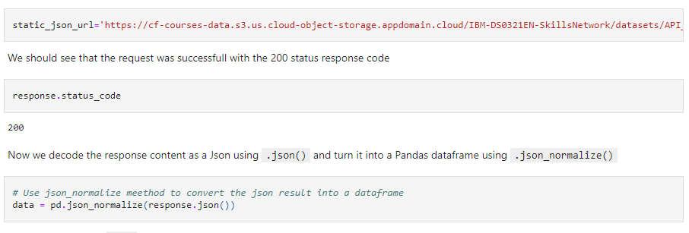
Data Collection – SpaceX API
The data was collected using GET Request on SPACEX API. We clean it and wrangling it.
Here is the notebook link:
https://github.com/molebatsipotso/IBM-SPACEX-DATA-SCIENCE-CAPSTONE/blob/main/jupyter-labs-spacex-data-collection-api.ipynb

Slide 9
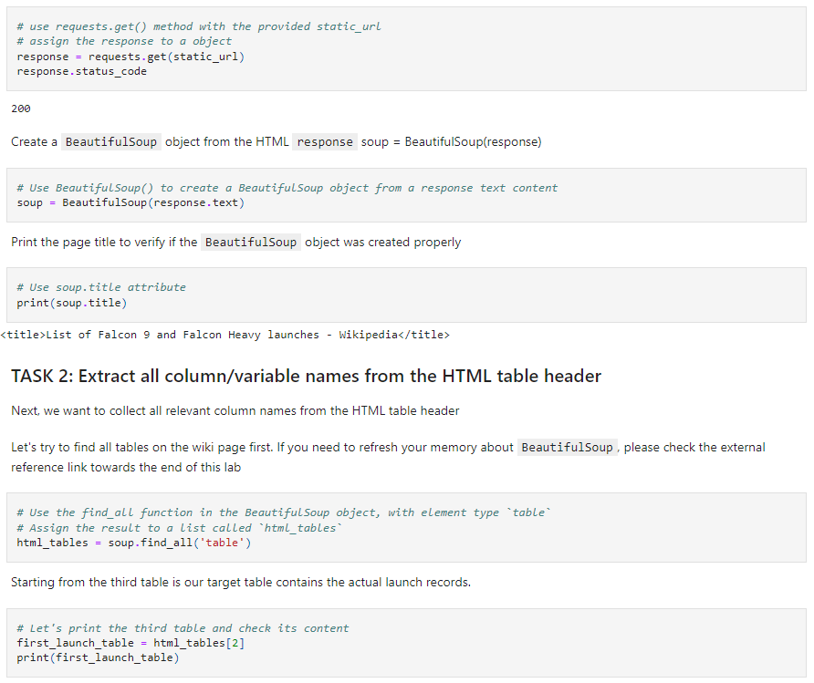
Data Collection - Scraping
Using a BeautifulSoup, we did web scraping to scrap records from Falcon 9. Then we converted the data to be in panda dataframe format.
Here is the link:
https://github.com/molebatsipotso/IBM-SPACEX-DATA-SCIENCE-CAPSTONE/blob/main/jupyter-labs-webscraping.ipynb
Place your flowchart of web scraping here

Slide 10
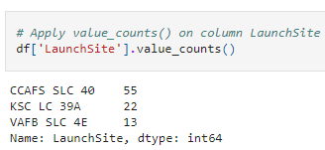
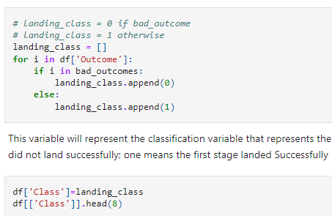
Data Wrangling
For our wrangling we performed exploratory data analysis and determined the training labels. Calculated the number of launches at each site, and how often they occur for each orbits. At the end we created a column to capture the landing outcome.
Here is the link:
https://github.com/molebatsipotso/IBM-SPACEX-DATA-SCIENCE-CAPSTONE/blob/main/labs-jupyter-spacex-Data%20wrangling.ipynb

Slide 11
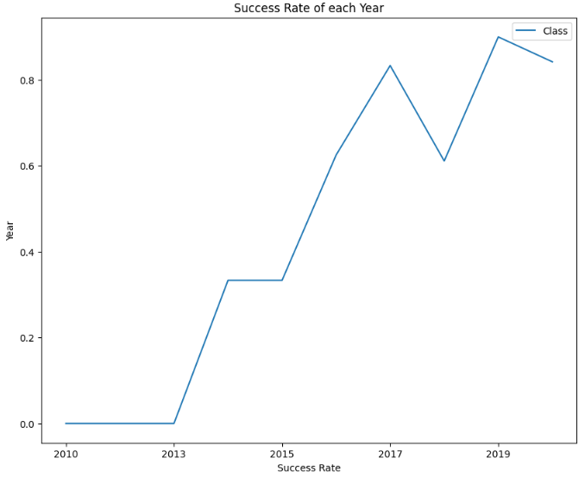
EDA with Data Visualization
We visualize the relationship between flight number and launch Site, payload and launch site, success rate of each orbit type, flight number and orbit type, the launch success yearly trend.
Here is the link:
https://github.com/molebatsipotso/IBM-SPACEX-DATA-SCIENCE-CAPSTONE/blob/main/jupyter-labs-eda-dataviz.ipynb.jupyterlite.ipynb

Slide 12
EDA with SQL
We use SQL queries to obtain insight on the data. Queries such as:
%sql SELECT * FROM SPACEXTBL limit 20;
%sql SELECT DISTINCT(Launch_Site) FROM SPACEXTBL;
%sql SELECT * FROM SPACEXTBL WHERE Launch_Site LIKE "%CCA%" LIMIT 5
%sql SELECT SUM(PAYLOAD_MASS__KG_) as payloadmass from SPACEXTBL;
%sql SELECT Landing_Outcome FROM SPACEXTBL WHERE Date BETWEEN '2010-06-04' AND '2017-03-20' ORDER BY Date DESC;
Here is the link:
https://github.com/molebatsipotso/IBM-SPACEX-DATA-SCIENCE-CAPSTONE/blob/main/jupyter-labs-eda-sql-coursera_sqllite.ipynb

Slide 13
Build an Interactive Map with Folium
To mark the success or failure on each launch site, we marked launch sites on folium map with circles and lines. The successful launch to classed to 1 and 0 was for failed launches.
We calculated the distances between a launch site to its proximities such as: railways, highways and coastlines
Here is the link:
https://github.com/molebatsipotso/IBM-SPACEX-DATA-SCIENCE-CAPSTONE/blob/main/lab_jupyter_launch_site_location.jupyterlite.ipynb

Slide 14
Build a Dashboard with Plotly Dash
Using Plotly, we built an interactive dashboard that shows insight such as:
Total launches for each sites
Relationship between outcome and payload mass for each booster version.
Here is the link:
https://github.com/molebatsipotso/IBM-SPACEX-DATA-SCIENCE-CAPSTONE/blob/main/spacex_dash_app.py

Slide 15
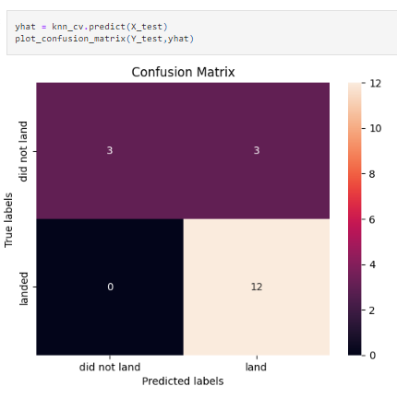
Predictive Analysis (Classification)
To preform the predictive analysis on the data, we split the data into training and testing data. Built different machine learning models using GridSearchCV and improve the accuracy of each models
Here is the link:
https://github.com/molebatsipotso/IBM-SPACEX-DATA-SCIENCE-CAPSTONE/blob/main/SpaceX_Machine_Learning_Prediction_Part_5.jupyterlite.ipynb

Slide 16
Results
Exploratory data analysis results
Interactive analytics demo in screenshots
Predictive analysis results

Slide 17

Section 2

Slide 18
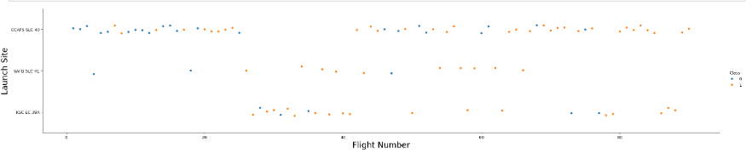
Flight Number vs. Launch Site
We can see that the larger the flight amount the greater the success rate at each launch site.

Slide 19
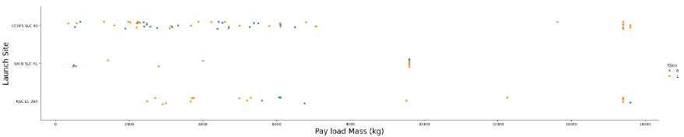
Payload vs. Launch Site
For the launch site CCAFS SLC40 we can see that the greater the payload mass, the higher the success rate.

Slide 20
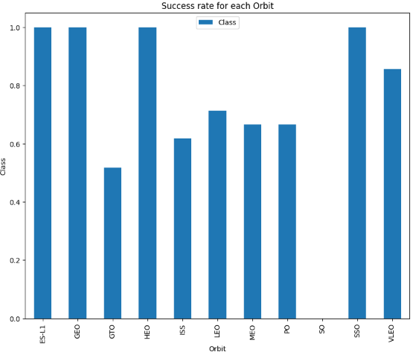
Success Rate vs. Orbit Type
The most success rate observed are from the orbit: ES-L1, GEO, HEO, SSO, and VLEO.

Slide 21
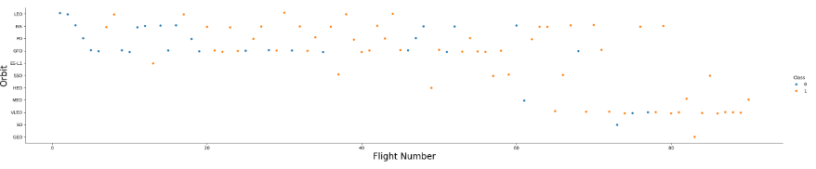
Flight Number vs. Orbit Type
We can see here that the launch success depends on the number of flights for LEO orbit.
However, for GTO orbit there is no clear relationship.

Slide 22
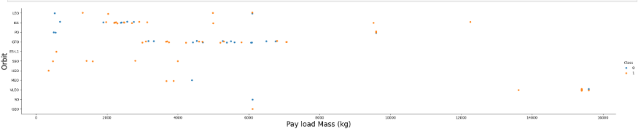
Payload vs. Orbit Type
The heavier the payloads, the more successful landing for PO, LEO and ISS orbits.

Slide 23
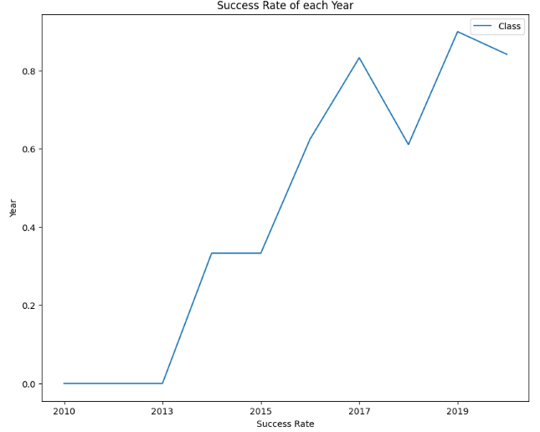
Launch Success Yearly Trend
The success rate has been increasing since 2013.

Slide 24
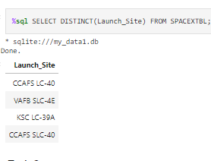
All Launch Site Names
We used distinct to show unique launch sites.

Slide 25
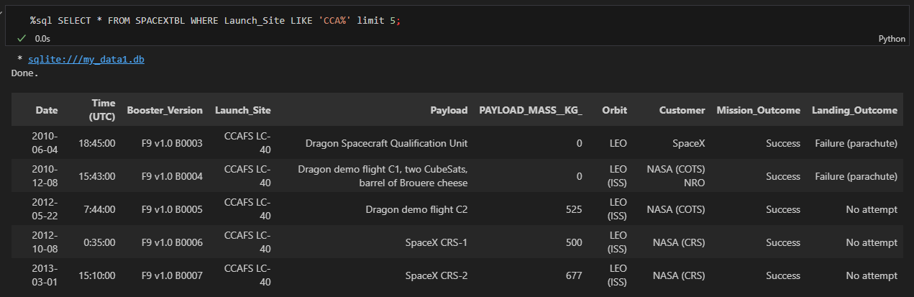
Launch Site Names Begin with 'CCA'
Using the query “LIKE” we display 5 records where launch sites begin with `CCA`

Slide 26
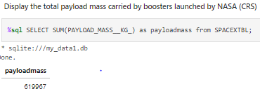
Total Payload Mass
The total payload carried by boosters from NASA is calculates as 619967

Slide 27
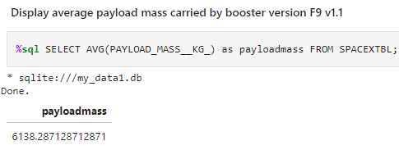
Average Payload Mass by F9 v1.1
The average payload mass carried by booster version F9 v1.1 was calculated as 6138.28

Slide 28
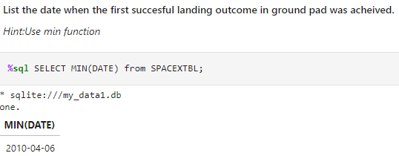
First Successful Ground Landing Date
The first successful landing outcome on ground pad was on 6th April 2010.

Slide 29
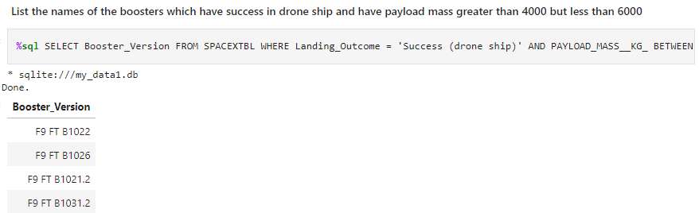
Successful Drone Ship Landing with Payload between 4000 and 6000
There were four successful drone ship landing with payload mass between 4000 and 6000.

Slide 30
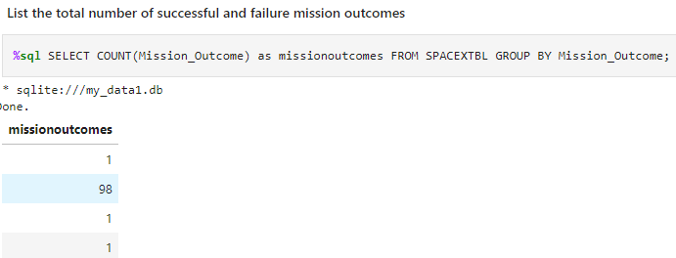
Total Number of Successful and Failure Mission Outcomes
We calculated the total number of success and failure of mission outcomes

Slide 31
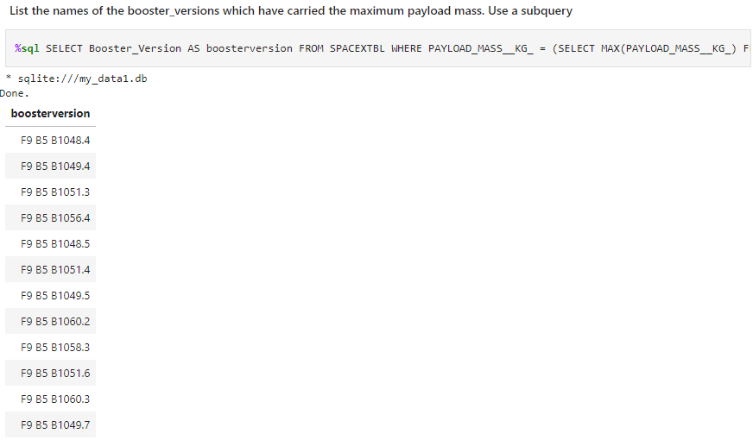
Boosters Carried Maximum Payload
List of the booster carried the maximum payload mass

Slide 32
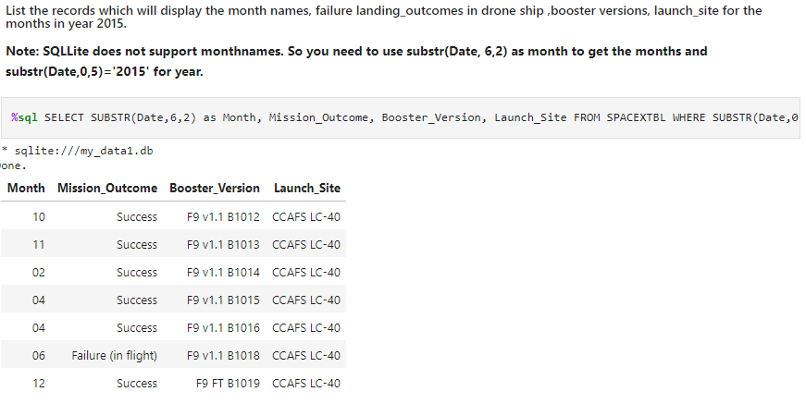
2015 Launch Records
List of the failed landing_outcomes in drone ship for the year 2015

Slide 33
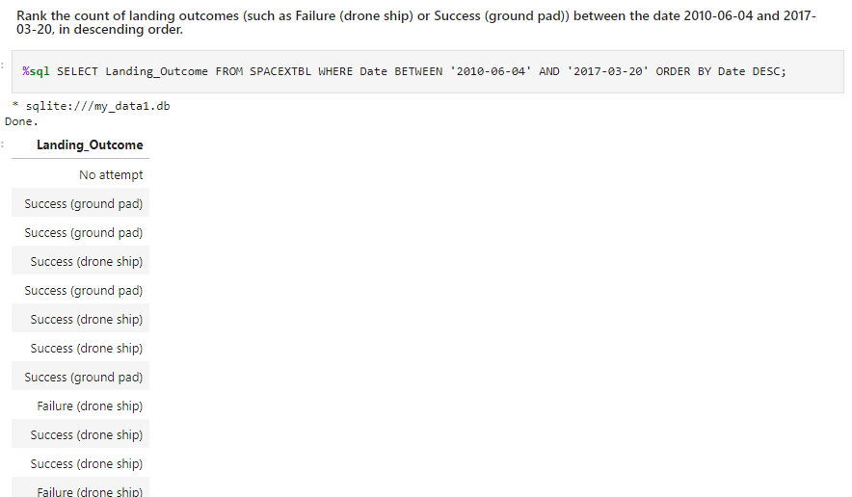
Rank Landing Outcomes Between 2010-06-04 and 2017-03-20
Ranking of landing outcomes (such as Failure (drone ship) or Success (ground pad)) between the date 2010-06-04 and 2017-03-20, in descending order

Slide 34

Section 3

Slide 35
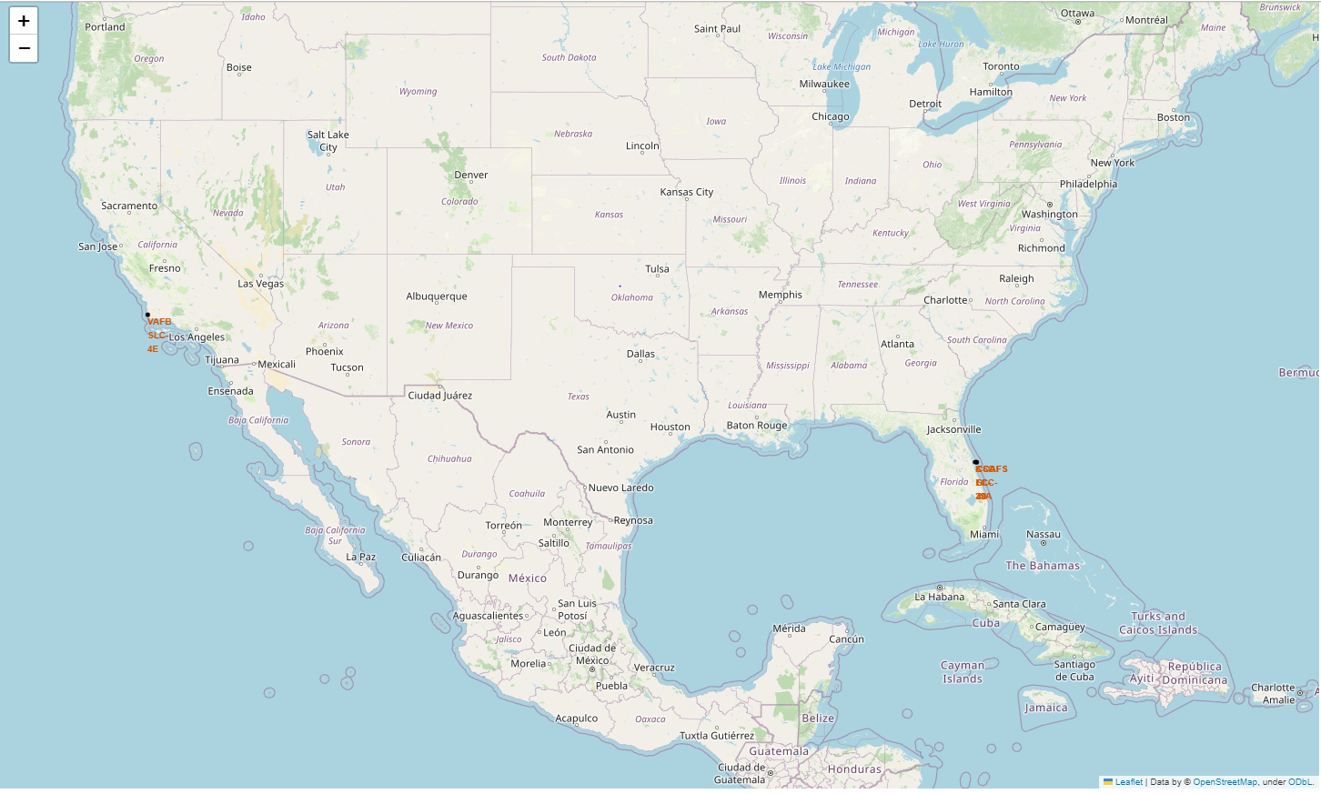
Global map with marked launch sites
Launch sites are all near the coastlines

Slide 36
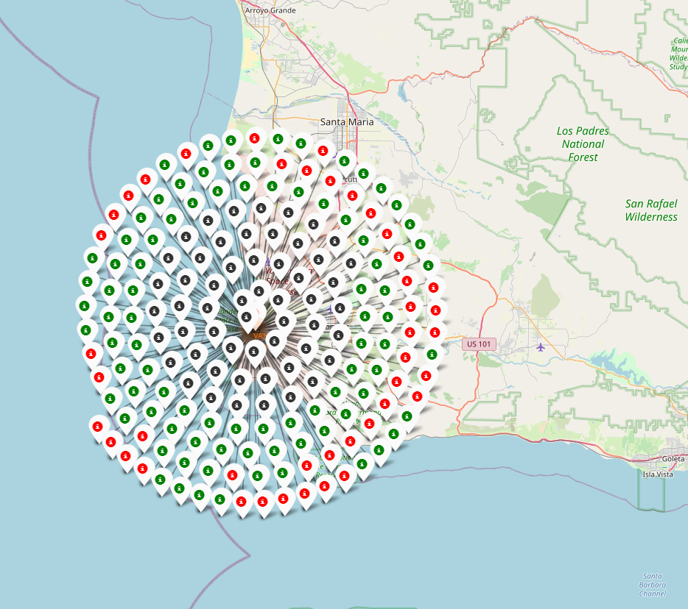
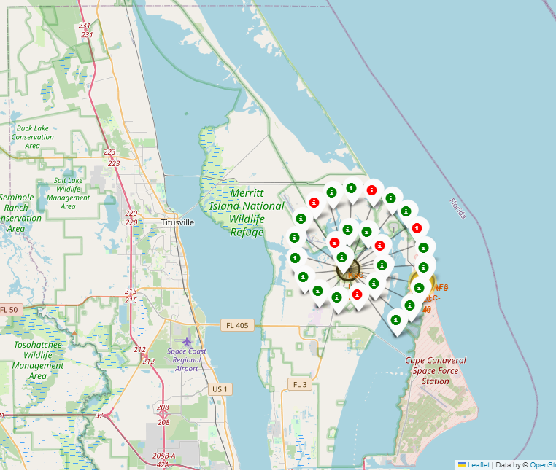
Launch site successful and failed launching
The green marker show the successful landing;
The red marker shows the failed landing.

Slide 37
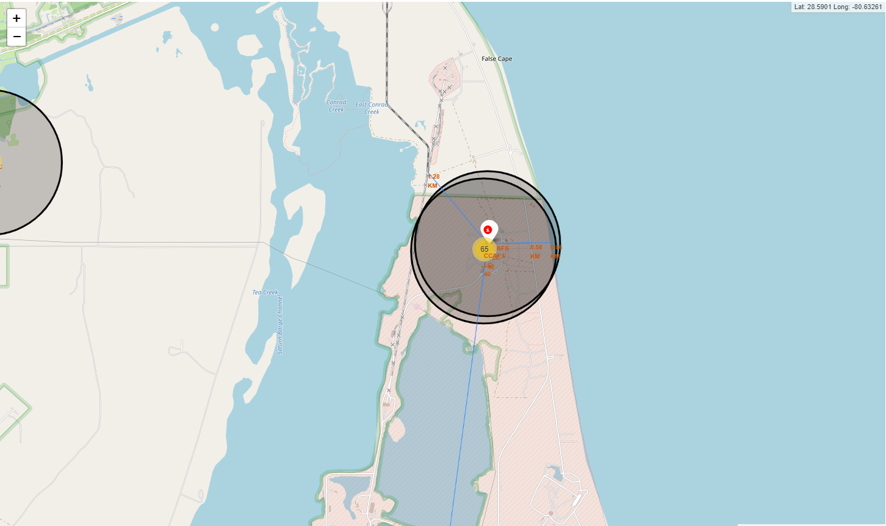
Launch site proximities
The blue line shows the distance to the nearest landmark site.

Slide 38

Section 4

Slide 39
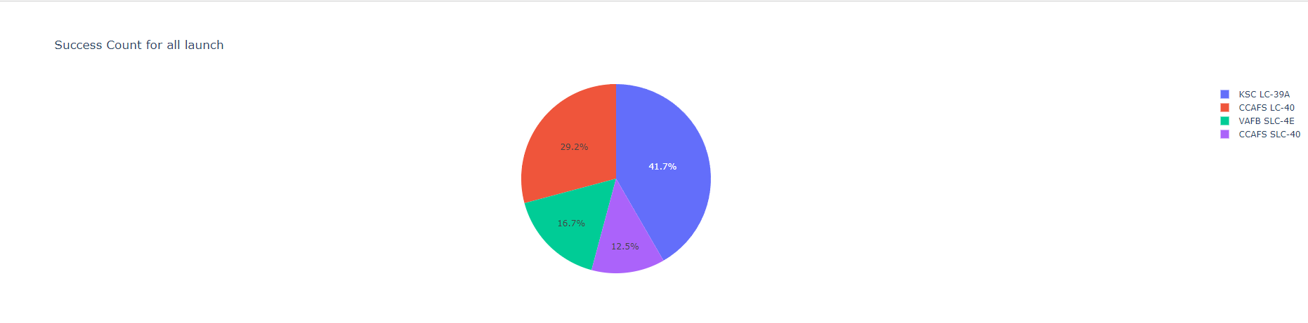
Percentage of success from each launch site
The launch site with the highest success rate is KSC LC-39A with success rate of 41.7%

Slide 40
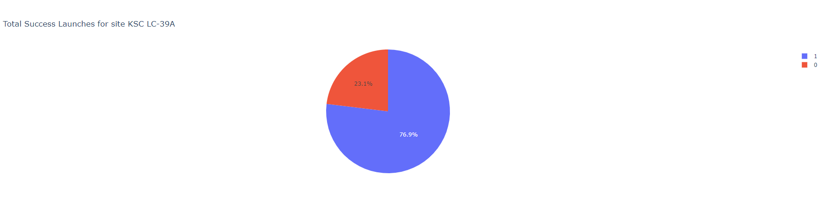
Success ratio for the Launch site with highest success rate
KSC LC-39A has the highest success rate with successful launches of 76.9% and failure of 23.1%.

Slide 41
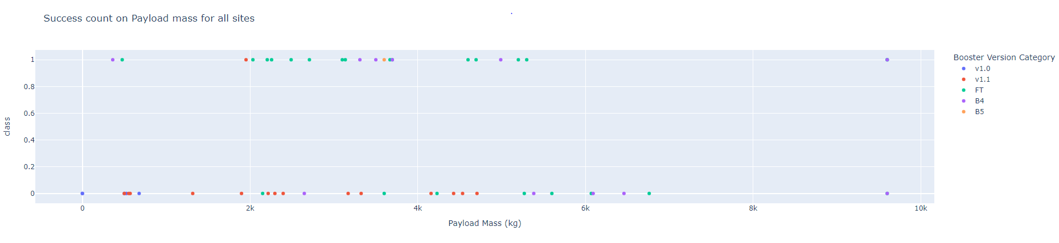
Launch success per payload mass
From the plot we can see that the success rate for payload of more than 6000kg is low.

Slide 42

Section 5

Slide 43
Classification Accuracy
The decision tree classifier is the model with highest classification accuracy

Slide 44
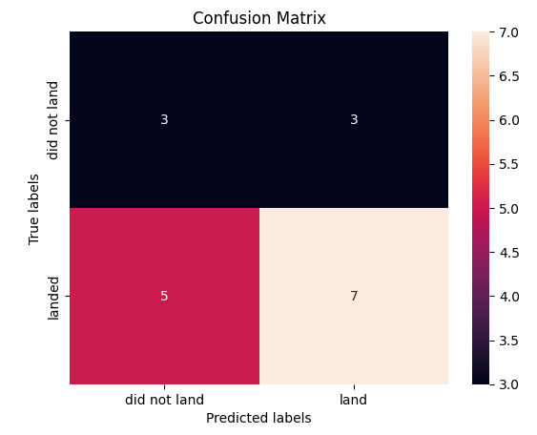
Confusion Matrix
The confusion matrix is a performance measure for a classification problem. It can have outputs of two or more.
In this study, we can see that the confusion matrix for the decision tree classifier shows that out of 18 missions, 12 were labeled as landed and 7 were correctly predicted and 5 were incorrectly predicted.

Slide 45
Conclusions
We can conclude from this study that:
Launch site with higher numbers of flight amounts has a greater success rate.
And we have observed that the launch success rate begin to improve from 2013.
We also observed that orbits with higher success rate are ES-L1, GEO, HEO, SSO, VLEO.
The sites with the most successful launches is KSC LC-39A.
The best model to use for predicting the success or failure of rocket landing is the decision tree classifier.

Slide 46


